Slide 1
The Physical Layer Chapter 2
Theoretical Basis for Data Communications
Guided Transmission Media
Wireless Transmission
Communication Satellites
Digital Modulation and Multiplexing
Public Switched Telephone Network
Mobile Telephone System
Cable Television

Slide 2
The Physical Layer
Foundation on which other layers build
Properties of wires, fiber, wireless limit what the network can do
Key problem is to send (digital) bits using only (analog) signals
This is called modulation
Application
Transport
Network
Link
Physical

Slide 3
Data and Signals
Type of data
Analog or digital
Type of signals
Analog or digital
Periodic or non-periodic
Terminology on transmission over a link
Simplex, half-duplex, or full-duplex
Parallel or serial

Slide 4
Type of Data
Analog data refers to information that is continuous
an analog clock that has hour, minute, and second hands gives information in a continuous form;
the movements of the hands are continuous.
Digital data refers to information that has discrete states
a digital clock that reports the hours and the minutes will change suddenly from 8:05 to 8:06.

Slide 5
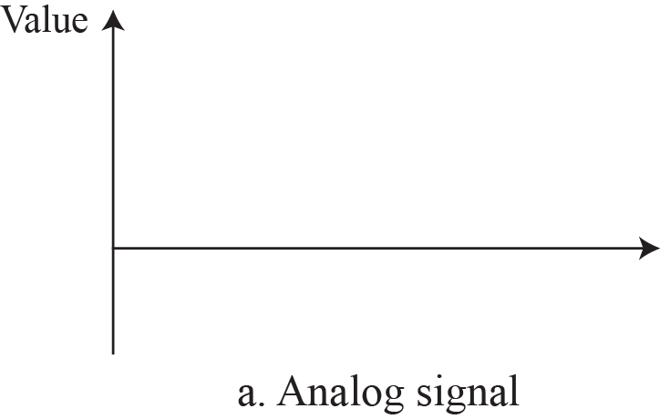
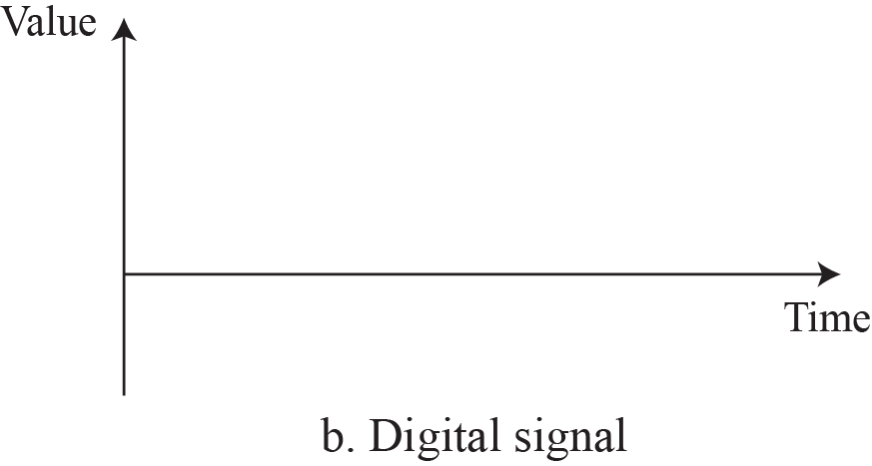
Analog and Digital Signals
An analog signal has infinitely many levels of intensity over a period of time.
A digital signal can have only a limited number of defined values.

Slide 6
Periodic and Non-periodic Signals
A periodic signal completes a pattern within a measurable time frame, called a period, and repeats that pattern over subsequent identical periods.
A simple periodic analog signal, a sine wave, cannot be decomposed into simpler signals. A sine wave is defined by its amplitude, frequency, phase.
A composite periodic analog signal is composed of multiple sine waves.
A non-periodic signal changes without exhibiting a pattern or cycle that repeats over time.
Most digital signals are non-periodic, and thus period and frequency are not appropriate characteristics.

Slide 7
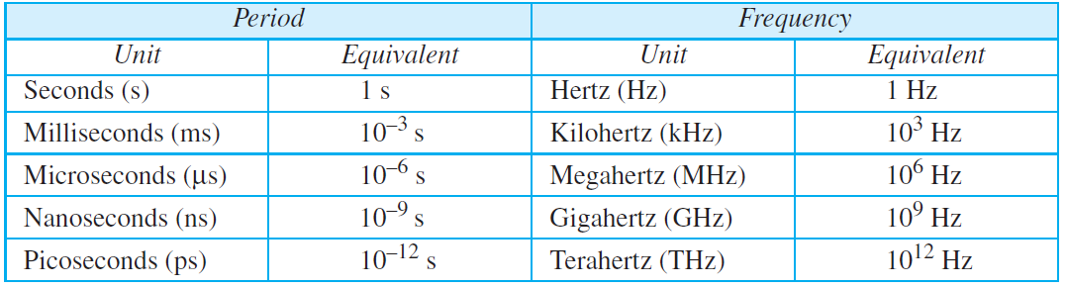
Units of period and frequency

Slide 8
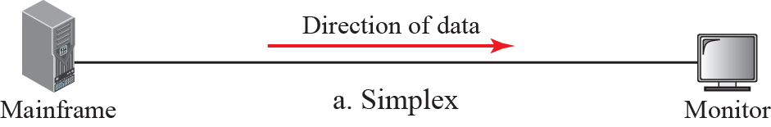
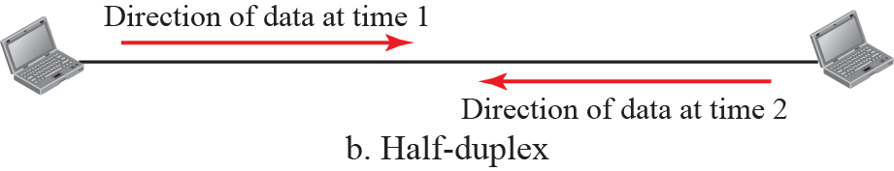
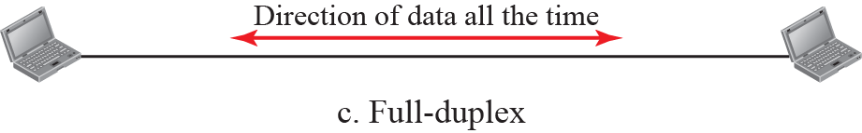
Simplex, half-duplex, or full-duplex
Notes:
The simplex mode can use the entire capacity of the channel to send data in one direction.
The half-duplex mode is used in cases where there is no need for communication in both directions at the same time; the entire capacity of the channel can be utilized for each direction.
The full-duplex mode is used when communication in both directions is required all the time. The capacity of the channel, however, must be divided between the two directions.

Slide 9
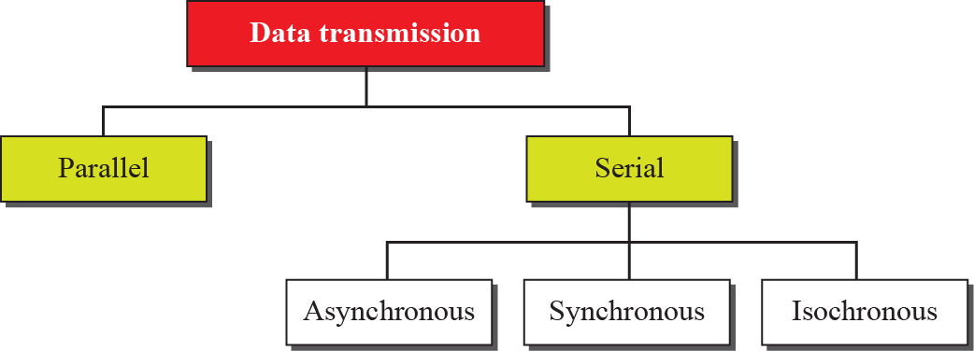
Data transmission modes
Notes:
The isochronous transmission guarantees that the data arrive at a fixed rate, esp. for real-time audio and video.

Slide 10
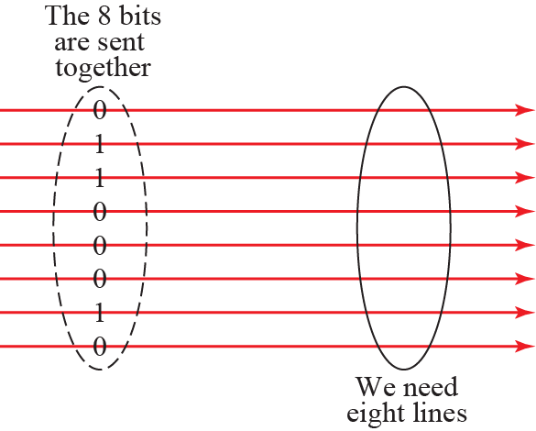


Parallel Transmission
At the sender, digital data are encoded into a digital signal.
At the receiver, the digital data are recreated by decoding the digital signal.
Notes:
Line coding is the process of converting digital data to digital signals.
Line coding converts a sequence of bits to a digital signal.

Slide 11
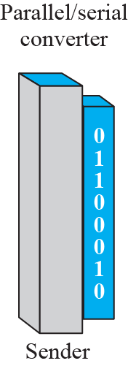
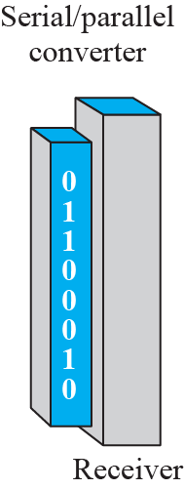
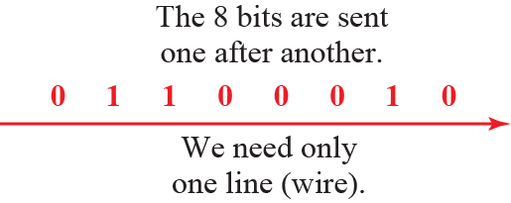
Serial Transmission

Slide 12
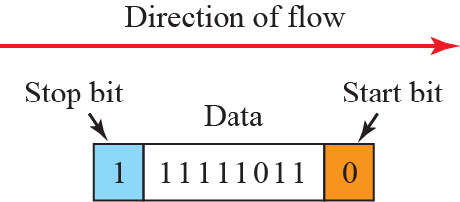

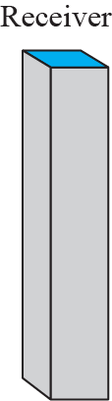
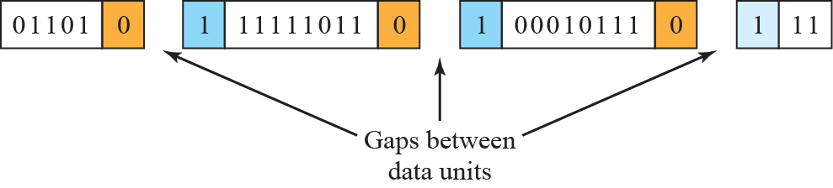
Asynchronous Transmission
The timing of a signal is unimportant.
Information is received and translated by agreed upon patterns.
Notes:
In asynchronous transmission, we send 1 start bit (0) at the beginning and 1 or more stop bits (1s) at the end of each byte. There may be a gap between bytes.
Asynchronous here means “asynchronous at the byte level,” but the bits are still synchronized; their durations are the same.

Slide 13


Synchronous Transmission
In synchronous transmission, we send bits one after another without start or stop bits or gaps. It is the responsibility of the receiver to group the bits.
Timing is very important.

Slide 14
Theoretical Basis for Data Communication
Communication rates have fundamental limits
Fourier analysis »
Bandwidth-limited signals »
Maximum data rate of a channel »

Slide 15
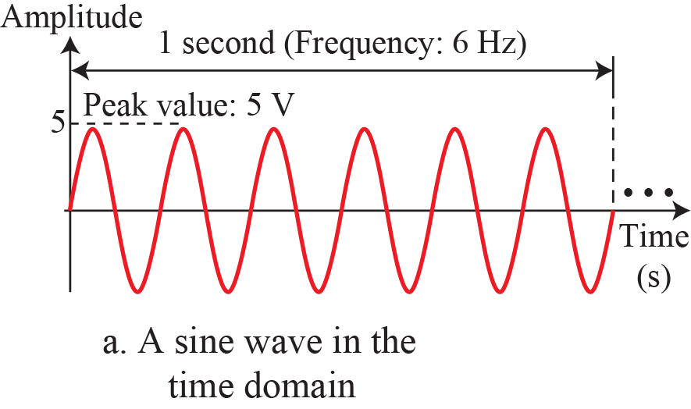
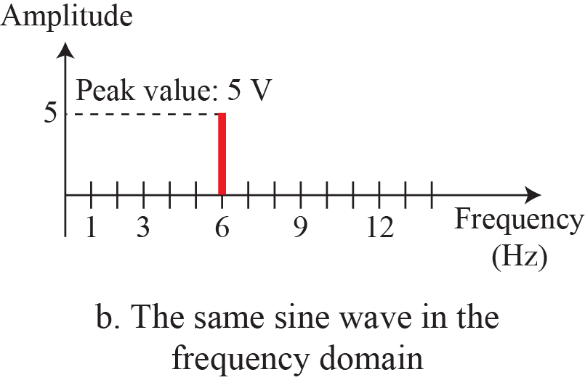
The time-domain and frequency-domain plots of a sine wave

Slide 16
Applications of simple sine waves
The power company sends a single sine wave with a frequency of 60 Hz to distribute electric energy to houses and businesses.
Use a single sine wave to send an alarm to a security center when a burglar opens a door or window in the house.

Slide 17
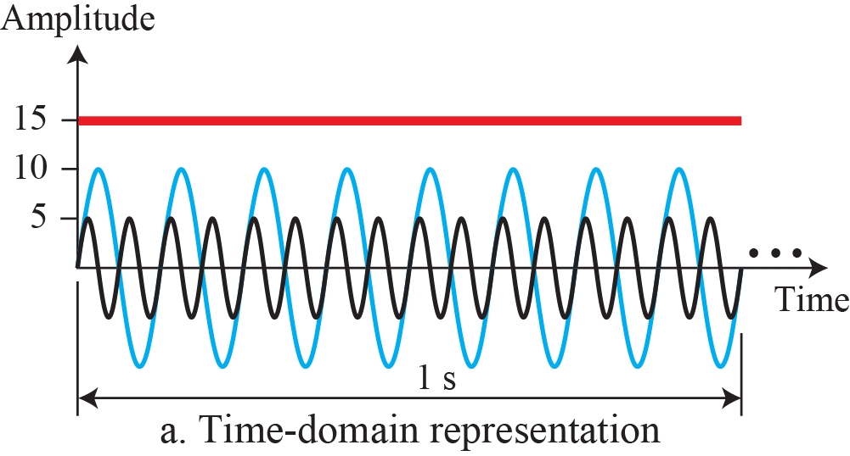
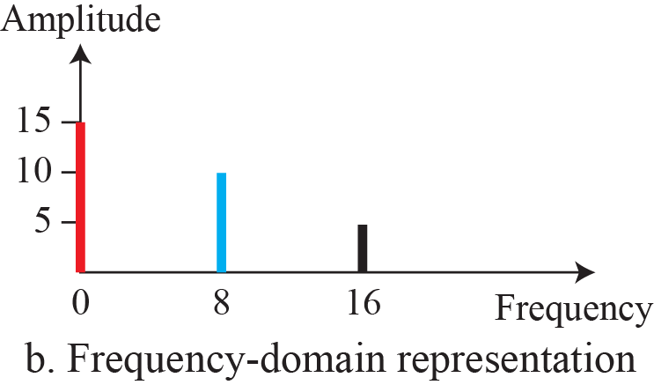
The time domain and frequency domain of three sine waves

Slide 18
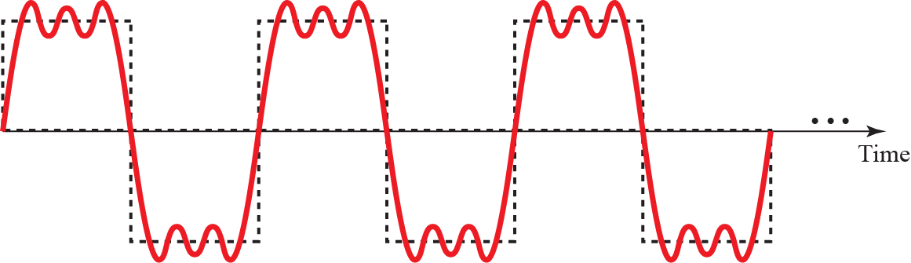
Decomposition of a composite periodic signal
Notes:
This type of signal is not typical of those found in data communications.

Slide 19
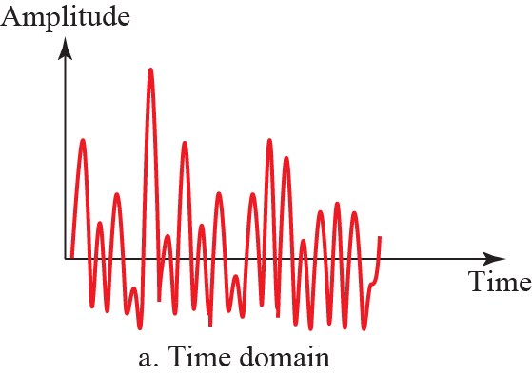
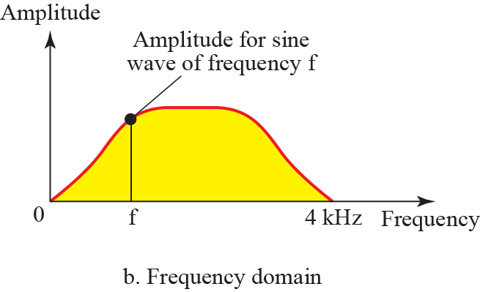
Time and frequency domain of a non-periodic composite signal
It can be the signal created by a microphone or a telephone set when a word or two is pronounced. In this case, the composite signal cannot be periodic, because that implies that we are repeating the same word or words with exactly the same tone.

Slide 20
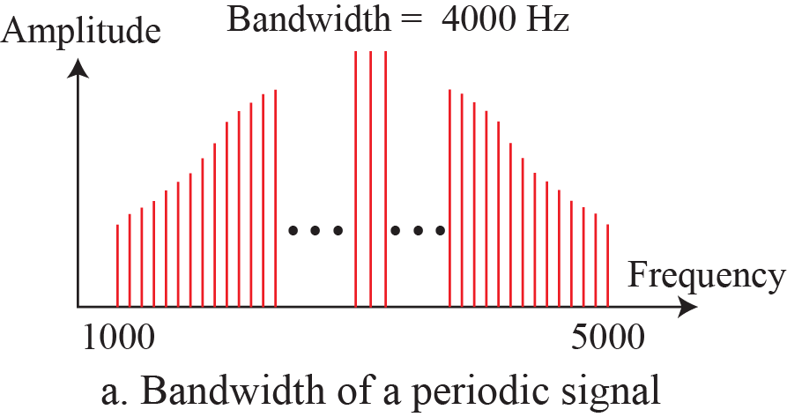
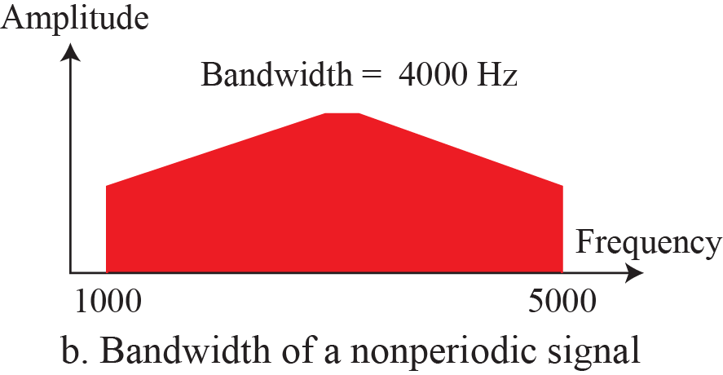
Bandwidth of analog signals

Slide 21
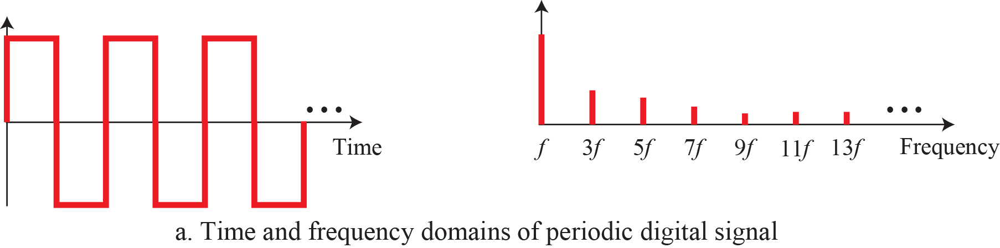
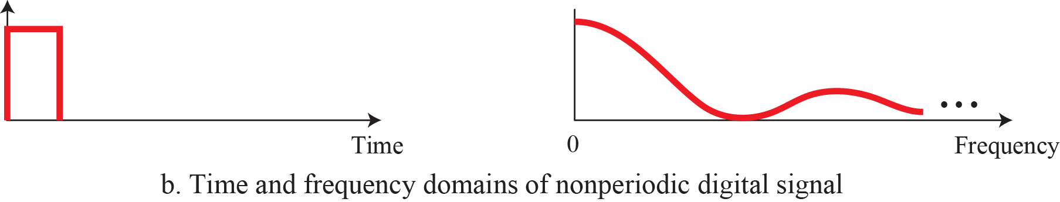
Bandwidth of digital signals
Based on Fourier analysis, a digital signal is a composite analog signal. The bandwidth is infinite.
Notes:
A digital signal, in the time domain, comprises connected vertical and horizontal line segments.
A vertical line in the time domain means a frequency of infinity: a horizontal line in the time domain means a frequency of zero. Going from a frequency of zero to a frequency of infinity implies all frequencies in between are part of the domain.

Slide 22
Bandwidth in hertz and bandwidth in bits per second
To electrical engineers, (analog) bandwidth is the range of frequencies, a quantity measured in Hz.
To computer scientists, (digital) bandwidth is the maximum data rate of a channel, a quantity measured in bits/sec.
The data rate is the end result of using the analog bandwidth of a physical channel for digital transmission.

Slide 23
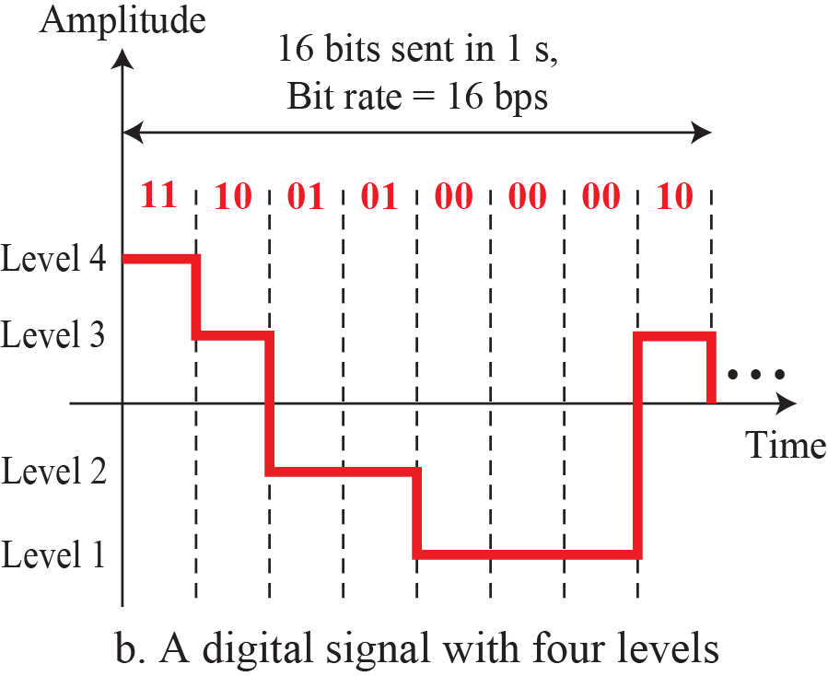
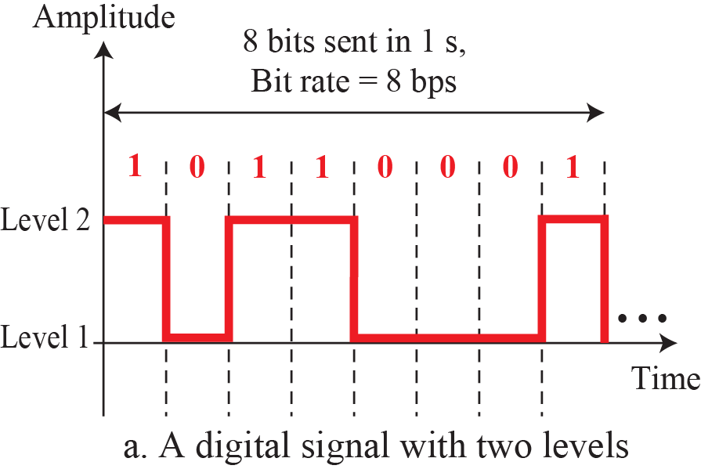
Bit Rate
For digital signals, the bit rate is the number of bits sent in 1 second, expressed in bits per second (bps).

Slide 24
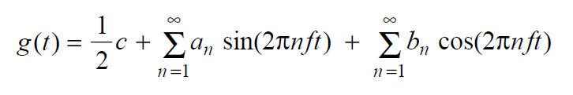
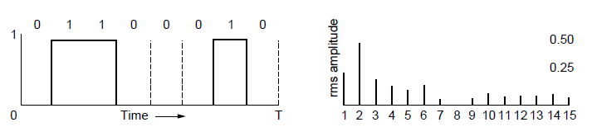
Fourier Analysis
A time-varying signal can be equivalently represented as a series of frequency components (harmonics):
=
Signal over time
a, b weights of harmonics

Slide 25
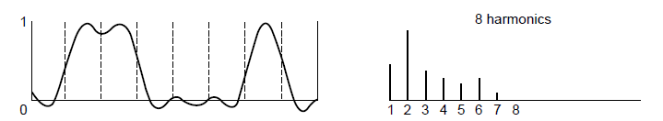
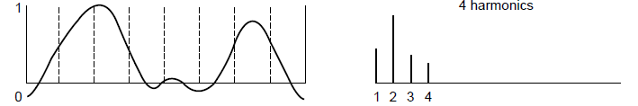
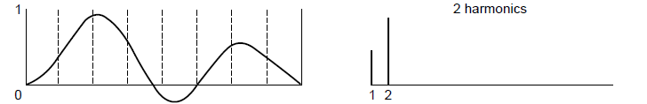
Bandwidth-Limited Signals
Having less bandwidth (harmonics) degrades the signal
8 harmonics
Lost!
Bandwidth
4 harmonics
Lost!
2 harmonics
Lost!
Notes:
How fast we can send data, in bits per second, over a channel?

Slide 26
Relation between data rate and harmonics
bps

Slide 27
How fast we can send data, in bits per second, over a channel?

Slide 28
Maximum Data Rate of a Channel
Nyquist’s theorem relates the data rate to the bandwidth (B) and number of signal levels (V) for a noiseless channel :
Shannon's theorem relates the data rate to the bandwidth (B) and signal strength (S) relative to the noise (N):
Max. data rate = 2B log₂V bits/sec
Max. data rate = B log₂(1 + S/N) bits/sec
Notes:
These are fundamental limits; real systems can only approach them.
S/N is called the signal to noise ratio SNR, and it is commonly measured in decibels on a logarithmic scale e.g., 10dB means the signal is 10X noise, 20dB means 100X noise, etc.

Slide 29
Exercises
We need to send 265 kbps over a noiseless channel with a bandwidth of 20 kHz. How many signal levels do we need?
Since this result is not a power of 2, we need to either increase the number of levels or reduce the bit rate. If we have 128 levels, the bit rate is 280 kbps. If we have 64 levels, the bit rate is 240 kbps.

Slide 30
The theoretical highest bit rate of a regular telephone line
A telephone line normally has a bandwidth of 3000 Hz (300 to 3300 Hz) assigned for data communications. The signal-to-noise ratio is usually 3162. The capacity of this channel is calculated as
This means that the highest bit rate for a telephone line is 34.860 kbps. If we want to send data faster than this, we can either increase the bandwidth of the line or improve the signal-to-noise ratio.

Slide 31
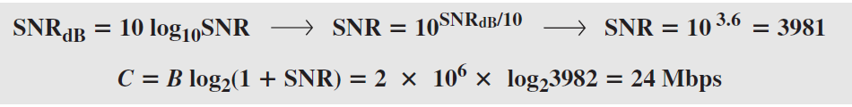
Decibel (dB)
The signal-to-noise ratio is often given in decibels.
Assume that SNR_{dB} = 36 and the channel bandwidth is 2 MHz. The theoretical channel capacity can be calculated as

Slide 32
Exercise
Consider an extremely noisy channel in which the value of the signal-to-noise ratio is almost zero. In other words, the noise is so strong that the signal is faint. For this channel the capacity C is calculated as
This means that the capacity of this channel is zero regardless of the bandwidth. In other words, we cannot receive any data through this channel.

Slide 33
The Physical Layer Chapter 2
Theoretical Basis for Data Communications
Guided Transmission Media
Wireless Transmission
Communication Satellites
Digital Modulation and Multiplexing
Public Switched Telephone Network
Mobile Telephone System
Cable Television

Slide 34
The Physical Layer
Foundation on which other layers build
Properties of wires, fiber, wireless limit what the network can do
Key problem is to send (digital) bits using only (analog) signals
This is called modulation
Application
Transport
Network
Link
Physical

Slide 35
Guided Transmission (Wires & Fiber)
Media have different properties, hence performance
Reality check
Storage media »
Wires:
Twisted pairs »
Coaxial cable »
Power lines »
Fiber cables »

Slide 36
Reality Check: Storage media
Send data on tape / disk / DVD for a high bandwidth link
Mail one box with 1000 800GB tapes (6400 Tbit)
Takes one day to send (86,400 secs)
Data rate is 70 Gbps.
Data rate is faster than long-distance networks!
But, the message delay is very poor.

Slide 37
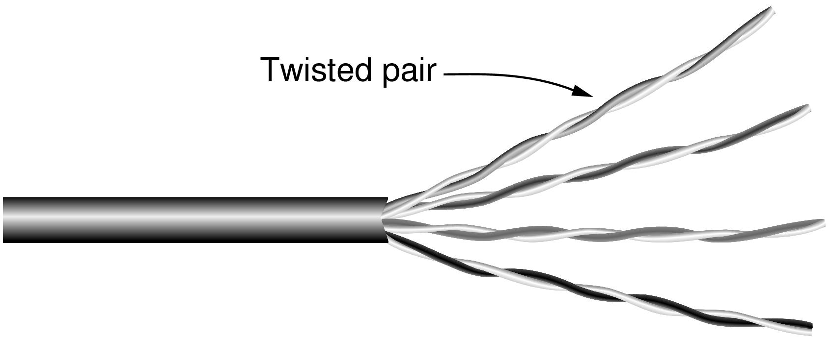
Wires – Twisted Pair
Very common; used in LANs, telephone lines
Twists reduce radiated signal (interference)
Category 5 UTP cable with four twisted pairs
Notes:
This is the garden variety cable used in most offices, e.g., as gigabit Ethernet cables. It is also the old-fashioned telephone line that reaches into your home. The twists reduce interference because the signal radiated from the wire at one location is largely canceled by the signal from the nearby twist; tighter twisting gives higher quality wires. UTP = unshielded twisted pair. STP = shielded twisted pair does exist to shield the wire from external noise for more demanding uses (higher data rates) but is it more expensive and difficult to work with.

Slide 38
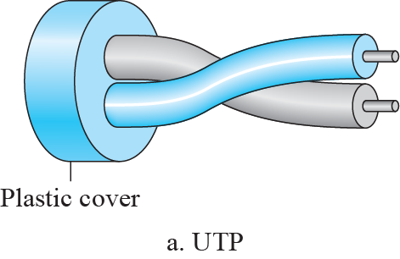
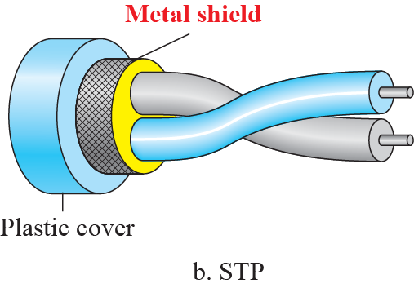
UTP VS. STP

Slide 39
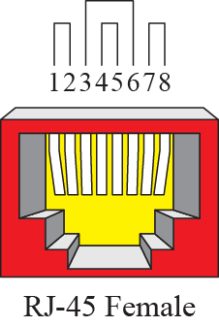
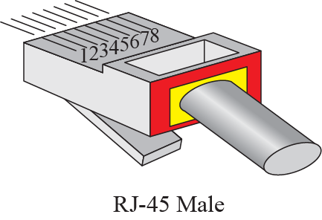
UTP-Connectors

Slide 40
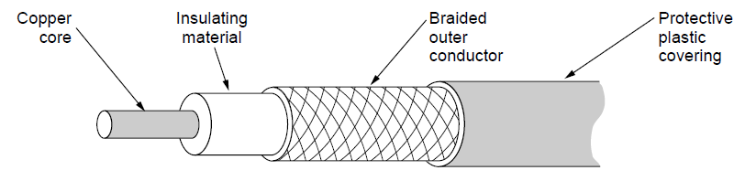
Wires – Coaxial Cable (“Co-ax”)
Also common. Better shielding and more bandwidth for longer distances and higher rates than twisted pair.
Notes:
A higher quality cable than UTP that can carry data at higher rates for longer distances, but is usually more expensive. Enclosing one wire within another provides better immunity to electrical noise. Commonly used for video, e.g., cable TV, because it needs larger bandwidth.

Slide 41
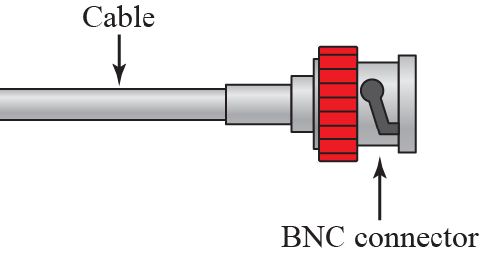
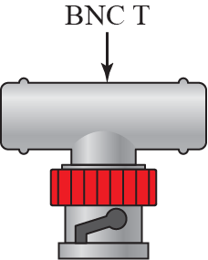
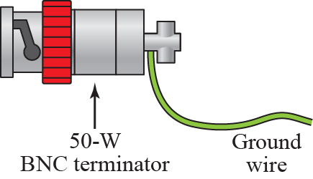
BNC Connectors

Slide 42
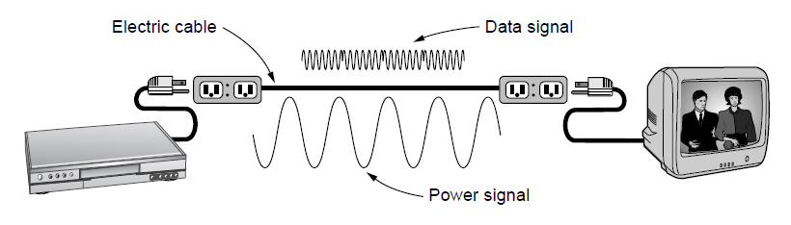
Wires – Power Lines
Household electrical wiring is another example of wires
Convenient to use, but horrible for sending data
Notes:
It is horrible because it carries power signals at the same time and the wiring was not designed for data communications, e.g., it is not tightly twisted like twisted pair, and its electrical properties change as devices that are plugged in turn on and off. But it is convenient because it is already installed and many devices are plugged in to get power, so people are starting to use it.

Slide 43
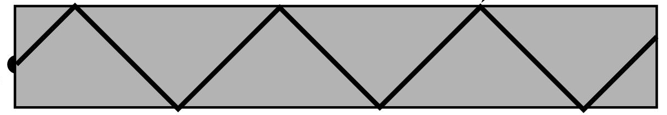


Fiber Cables (1)
Common for high rates and long distances
Long distance ISP links, Fiber-to-the-Home
Light carried in very long, thin strand of glass
Light source
(LED, laser)
Light trapped by
total internal reflection
Photodetector
Notes:
The other main kind of guided media is optical fiber. It is widely used for links that run at high rates, particularly over long distances. It is much, much better than wire in both regards. Examples include the backbone links between ISP facilities, and fiber runs to the home (FTTH) that provide much higher bandwidth home connectivity than ADSL. The optical fiber is a very long, thin strand of glass. The figure shows the overall system. A light source is needed to produce pulses of light, either a LED or a laser (better quality, more expensive). The pulses of light are trapped in the fiber (total internal reflection) and follow it. At the other end a photodetector turns pulses of light into electrical signals.

Slide 44
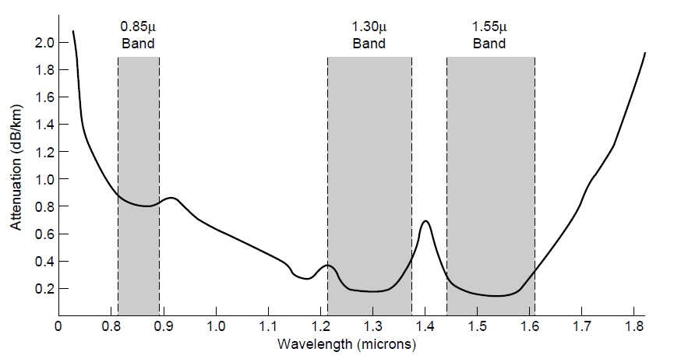
Fiber Cables (2)
Fiber has enormous bandwidth (THz) and tiny signal loss – hence high rates over long distances
Notes:
This slide shows why fiber runs for high rates and long distances – attenuation is very low (can go 10km before the signal has lost 3dB or half its power) for enormous regions of bandwidth (30 *Terahertz* when wavelength is converted to frequency).

Slide 45
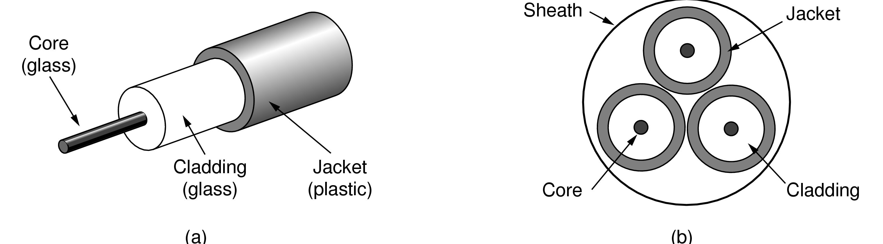
Fiber Cables (3)
Single-mode
Core so narrow (10um) light can’t even bounce around
Used with lasers for long distances, e.g., 100km
Multi-mode
Other main type of fiber
Light can bounce (50um core)
Used with LEDs for cheaper, shorter distance links
Fibers in a cable

Slide 46
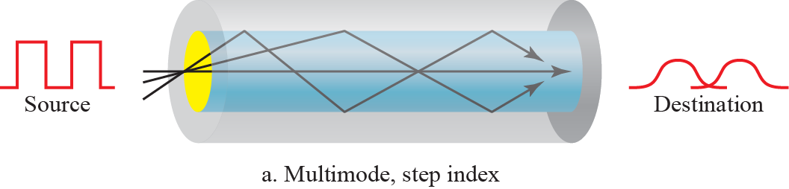
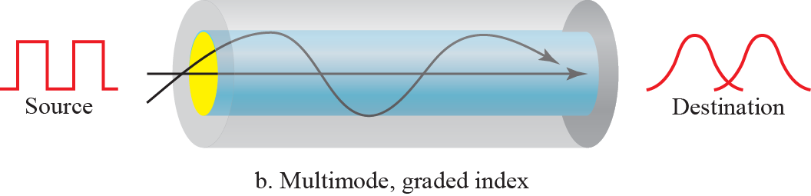
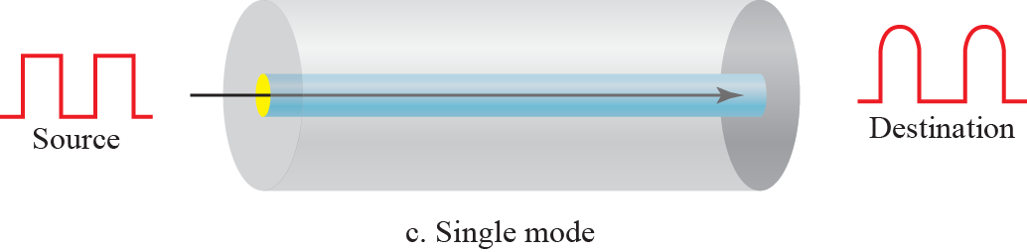
Propagation Modes

Slide 47
Fiber Cables (4)
Comparison of the properties of wires and fiber:
Property | Wires | Fiber
Distance | Short (100s of m) | Long (tens of km)
Bandwidth | Moderate | Very High
Cost | Inexpensive | Less cheap
Convenience | Easy to use | Less easy
Security | Easy to tap | Hard to tap
Notes:
Fiber gives you very high rates over long runs; wires score less highly on these properties and support high rates over much shorter runs. But wires are usually the inexpensive solution when the transmission/reception hardware is included. Wires are also easier to work with; fiber requires greater care with connections. Fiber has the advantage that it is very hard to tap as the light is confined only to the fiber or the fiber is broken. Wires are usually easy to tap because they radiate the signal well.

Slide 48
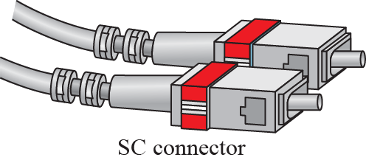


Fiber-optic cable connector

Slide 49
Information Wave Carried
Frequency and wave length λf = c（3x10⁸ m/s）
Δf = c Δλ/ λ²
Example: It is desired to send a sequence of computer screen images over an optical fiber. The screen is 1024x768 pixels, each pixel being 24 bits. There are 60 screen images per second. How much bandwidth is needed, and how many microns of wavelength are needed for this band at 1.3 microns?

Slide 50
Solution:
(1) The data rate is 1024 ×768 ×24 ×60 bps, which is 1080 Mbps.
(2) For simplicity, let us assume 1 bps per Hz.
we get Δ λ =λ² Δ f /c. We have Δ f = 1.08 ×10 ⁹ , so Δ λ =6.08 ×10 ⁻¹⁰ microns. The range of wavelengths used is very short.

Slide 51
Wireless Transmission
Electromagnetic Spectrum »
Radio Transmission »
Microwave Transmission »
Light Transmission »
Wireless vs. Wires/Fiber »

Slide 52

Electromagnetic Spectrum (1)
Different bands have different uses:
Radio: wide-area broadcast; Infrared/Light: line-of-sight
Microwave: LANs and 3G/4G;
Networking focus
Microwave

Slide 53

Electromagnetic Spectrum (2)
To manage interference, spectrum is carefully divided, and its use regulated and licensed, e.g., sold at auction.
300 MHz
3 GHz
WiFi (ISM bands)
3 GHz
Source: NTIA Office of Spectrum Management, 2003
30 GHz
Part of the US frequency allocations
Notes:
TV, cellular, satellite frequencies are heavily regulated.

Slide 54


Bands

Slide 55

Propagation Methods

Slide 56

Electromagnetic Spectrum (3)
Fortunately, there are also unlicensed (“ISM”) bands:
Free for use at low power; devices manage interference
Widely used for networking; WiFi, Bluetooth, Zigbee, etc.
802.11
b/g/n
802.11a/g/n
Notes:
These bands are used for WiFi, etc., not for cellular.

Slide 57


Radio Transmission
Radio signals penetrate buildings well and propagate for long distances with path loss
In the VLF, LF, and MF bands, radio waves follow the curvature of the earth
In the HF band, radio waves bounce off the ionosphere.
Notes:
The path loss makes the signal fall of at least as fast as 1/d^2 due to the RF energy being spread out over a greater region.

Slide 58

Microwave Transmission
Microwaves have much bandwidth and are widely used indoors (WiFi) and outdoors (3G, satellites)
Signal is attenuated/reflected by everyday objects
Strength varies with mobility due multipath fading, etc.
Notes:
The variation in signal strength as the sender/receiver move is a key hallmark of wireless. It means that data rates over wireless links can change dramatically; they are not fixed like a wire.
electromagnetic waves ranging in frequencies between 3 kHz and 1 GHz are normally called radio waves;
waves ranging in frequencies between 1 and 300 GHz are called microwaves.
Microwaves are unidirectional.

Slide 59



Light Transmission
Line-of-sight light (no fiber) can be used for links
Light is highly directional, has much bandwidth
Use of LEDs/cameras and lasers/photodetectors

Slide 60
Wireless vs. Wires/Fiber
Wireless:
Easy and inexpensive to deploy
Naturally supports mobility
Naturally supports broadcast
Transmissions interfere and must be managed
Signal strengths hence data rates vary greatly
Wires/Fiber:
Easy to engineer a fixed data rate over point-to-point links
Can be expensive to deploy, esp. over distances
Doesn’t readily support mobility or broadcast

Slide 61
Communication Satellites
Satellites are effective for broadcast distribution and anywhere/anytime communications
Kinds of Satellites »
Geostationary (GEO) Satellites »
Low-Earth Orbit (LEO) Satellites »
Satellites vs. Fiber »

Slide 62

Kinds of Satellites
Satellites and their properties vary by altitude:
Geostationary (GEO), Medium-Earth Orbit (MEO), and Low-Earth Orbit (LEO)
Sats needed for global coverage
Notes:
MEO is used for navigation systems such as the GPS (Global Positioning System) rather than data communications.

Slide 63

Satellite frequency bands

Slide 64

Geostationary Satellites
GEO satellites orbit 35,000 km above a fixed location
VSAT (computers) can communicate with the help of a hub
Different bands (L, S, C, Ku, Ka) in the GHz are in use but may be crowded or susceptible to rain.
GEO satellite
VSAT

Slide 65

Low-Earth Orbit Satellites
Systems such as Iridium use many low-latency satellites for coverage and route communications via them
The Iridium satellites form six necklaces around the earth.
Notes:
Since the satellites are LEO, it does not take long for signals from the Earth to go up and down compared to GEO satellites.

Slide 66
Satellite vs. Fiber
Satellite:
Can rapidly set up anywhere/anytime communications (after satellites have been launched)
Can broadcast to large regions
Limited bandwidth and interference to manage
Fiber:
Enormous bandwidth over long distances
Installation can be more expensive/difficult

Slide 67
The Physical Layer Chapter 2
Theoretical Basis for Data Communications
Guided Transmission Media
Wireless Transmission
Communication Satellites
Digital Modulation and Multiplexing
Public Switched Telephone Network
Mobile Telephone System
Cable Television

Slide 68
The Physical Layer
Foundation on which other layers build
Properties of wires, fiber, wireless limit what the network can do
Key problem is to send (digital) bits using only (analog) signals
This is called modulation
Application
Transport
Network
Link
Physical

Slide 69
Digital Modulation and Multiplexing
Modulation schemes send bits as signals; multiplexing schemes share a channel among users.
Baseband Transmission »
Passband Transmission »
Frequency Division Multiplexing »
Time Division Multiplexing »
Code Division Multiple Access »

Slide 70

Baseband Transmission
Line codes send symbols that represent one or more bits
NRZ is the simplest, literal line code (+1V=“1”, -1V=“0”)
Other codes tradeoff bandwidth and signal transitions
Four different line codes
Notes:
(c) NRZ Invert (NRZI): 1对应的信号形式有误，信号持续时间内无翻转。翻转发生在信号交界处
中文版教材中的图2-20的码型错行了，左侧文字要上移，具体参考课件中英文版的图。

Slide 71
Criteria of good line coding schemes
Bandwidth efficiency
DC Components
When the voltage level in a digital signal is constant for a while, the spectrum creates very low frequencies (results of Fourier analysis) around zero, presenting problems for a system that cannot pass low frequencies.
DC component means 0/1 parity that can cause baseline wandering, i.e., a long string of 0s or 1s can cause a drift in the baseline and make it difficult for the receiver to decode correctly.
Clock recovery / Self-synchronization
A self-synchronizing digital signal includes timing information in the data being transmitted.
This can be achieved if there are transitions in the signal that alert the receiver to the beginning, middle, or end of the pulse.
Notes:
Baseline Wandering
In decoding a digital signal, the receiver calculates a running average of the received signal power. This average is called the baseline.
The incoming signal power is evaluated against this baseline to determine the value of the data element.
A long string of 0s or 1s can cause a drift in the baseline (baseline wandering) and make it difficult for the receiver to decode correctly.
DC Components
When the voltage level in a digital signal is constant for a while, the spectrum creates very low frequencies (results of Fourier analysis) around zero, presenting problems for a system that cannot pass low frequencies.

Slide 72



Unipolar and Polar schemes
Unipolar NRZ scheme
Polar schemes (RZ)
Polar schemes (NRZ-L and NRZ-I)

Slide 73

Manchester and Differential Manchester

Slide 74


Bipolar schemes and Multilevel
Bipolar schemes: AMI and pseudoternary
Multilevel: 2B1Q

Slide 75

Summary of line coding schemes

Slide 76
Clock Recovery
To decode the symbols, signals need sufficient transitions
Otherwise long runs of 0s (or 1s) are confusing, e.g.:
Strategies:
Manchester coding, mixes clock signal in every symbol
4B/5B maps 4 data bits to 5 coded bits with 1s and 0s:
Scrambler XORs tx/rx data with pseudorandom bits
1
0 0 0 0 0 0 0 0 0 0 um, 0? er, 0?
Data | Code | Data | Code | Data | Code | Data | Code
0000 | 11110 | 0100 | 01010 | 1000 | 10010 | 1100 | 11010
0001 | 01001 | 0101 | 01011 | 1001 | 10011 | 1101 | 11011
0010 | 10100 | 0110 | 01110 | 1010 | 10110 | 1110 | 11100
0011 | 10101 | 0111 | 01111 | 1011 | 10111 | 1111 | 11101
Notes:
Strategies go from simplest to more complex and make progressively better use of bandwidth:
-Manchester is simple (every symbol has an embedded transition) but uses twice the bandwidth of a data signal
-4B/5B ensures no more than three 0s in a row (1s can be handled by making the signal level change to represent a 1) and needs 1.25X bandwidth（designed to be used in combination with NRZ-I.）
-scrambler needs no extra bandwidth (just data XOR sequence XOR sequence = data) but only makes long runs of 0s or 1s a low probability event

Slide 77

AMI used with scrambling

Slide 78


Two cases of B8ZS scrambling technique

Slide 79

Passband Transmission (1)
Modulating the amplitude, frequency/phase of a carrier signal sends bits in a (non-zero) frequency range
NRZ signal of bits
Amplitude shift keying
Frequency shift keying
Phase shift keying

Slide 80

Passband Transmission (2)
Constellation diagrams are a shorthand to capture the amplitude and phase modulations of symbols:
BPSK
2 symbols
1 bit/symbol
QPSK
4 symbols
2 bits/symbol
QAM-16
16 symbols
4 bits/symbol
QAM-64
64 symbols
6 bits/symbol
BPSK/QPSK varies only phase
QAM varies amplitude and phase

Slide 81

Passband Transmission (3)
Gray-coding assigns bits to symbols so that small symbol errors cause few bit errors:
B
E
A
C
D

Slide 82

Dividing a link into channels
Notes:
Multiplexing is the set of techniques that allows the simultaneous transmission of multiple signals across a single data link.
As data and telecommunications use increases, so does traffic.
We can accommodate this increase by continuing to add individual links each time a new channel is needed, or we can install higher-bandwidth links and use each to carry multiple signals.

Slide 83

Categories of multiplexing

Slide 84

Frequency Division Multiplexing (1)
FDM (Frequency Division Multiplexing) shares the channel by placing users on different frequencies:
Overall FDM channel

Slide 85

Frequency Division Multiplexing (2)
OFDM (Orthogonal FDM) is an efficient FDM technique used for 802.11, 4G cellular and other communications
Subcarriers are coordinated to be tightly packed
Notes:
When sending digital data, it is possible to divide the spectrum efficiently without using guard bands.
In OFDM (Orthogonal Frequency Division Multiplexing), the channel bandwidth is divided into many subcarriers that independently send data (e.g., with QAM).
The subcarriers are packed tightly together in the frequency domain. Thus, signals from each subcarrier extend into adjacent ones.
The frequency response of each subcarrier is designed so that it is zero at the center of the adjacent subcarriers. The subcarriers can therefore be sampled at their center frequencies without interference from their neighbors. To make this work, a guard time is needed to repeat a portion of the symbol signals in time so that they have the desired frequency response.

Slide 86

Time Division Multiplexing (TDM)
Time division multiplexing shares a channel over time:
Users take turns on a fixed schedule; this is not packet switching or STDM (Statistical TDM)
Widely used in telephone / cellular systems

Slide 87


Synchronous TDM vs. Statistical TDM

Slide 88
Code Division Multiple Access (CDMA)
CDMA shares the channel by giving users a code
Codes are orthogonal; can be sent at the same time
Widely used as part of 3G networks
Sender Codes
Transmitted
Signal
Receiver Decoding
+1
+1
S x A
+2
+2
Sum = 4
A sent “1”
A =
-1
-1
0
0
+2
+1
+1
0
0
Sum = -4
B sent “0”
B =
0
0
S x B
-1
-1
-2
-2
-2
+1
+1
S = +A -B
S x C
+2
Sum = 0
C didn’t send
C =
-1
-1
0
0
-2

Slide 89
The Public Switched Telephone Network
Structure of the telephone system »
Politics of telephones »
Local loop: modems, ADSL, and FTTH »
Trunks and multiplexing »
Switching »

Slide 90

Structure of the Telephone System
A hierarchical system for carrying voice calls made of:
Local loops, mostly analog twisted pairs to houses
Trunks, digital fiber optic links that carry calls
Switching offices, that move calls among trunks

Slide 91

The Politics of Telephones
In the U.S., there is a distinction for competition between serving a local area (LECs) and connecting to a local area (at a POP) to switch calls across areas (IXCs)
Customers of a LEC can dial via any IXC they choose
Notes:
This distinction is to encourage competition by splitting the local and long distance markets. Another regulation to promote competition is local number portability, i.e., you can take your telephone number when you change carriers, to make changing easier.

Slide 92

Local loop (1): modems
Telephone modems send digital data over an 3.3 KHz analog voice channel interface to the POTS
Rates <56 kbps; early way to connect to the Internet
Notes:
POTS = plain old telephone network, i.e., the traditional voice calls in the PSTN without modern improvements like DSL.

Slide 93


Local loop (2): Digital Subscriber Lines
DSL broadband sends data over the local loop to the local office using frequencies that are not used for POTS
Telephone/computers attach to the same old phone line
Rates vary with line
ADSL2 up to 12 Mbps
OFDM is used up to 1.1 MHz for ADSL2
Most bandwidth down
Notes:
ADSL for “asymmetric DSL” is the most popular version of DSL. The asymmetric means that greater bandwidth hence greater data rates are allocated to downstream traffic.

Slide 94

Local loop (3): Fiber To The Home
FTTH broadband relies on deployment of fiber optic cables to provide high data rates customers
One wavelength can be shared among many houses
Fiber is passive (no amplifiers, etc.)

Slide 95





Pulse Code Modulation
The most common technique to change an analog signal to digital data (digitization) is called pulse code modulation (PCM).

Slide 96
Nyquist Sampling Theory
According to the Nyquist theorem, the sampling rate must be at least 2 times the highest frequency contained in the signal.
ATTENTION: the highest frequency is not the bandwidth.
If the analog signal is low-pass, the bandwidth and the highest frequency are the same value.
If the analog signal is bandpass, the bandwidth value is lower than the value of the maximum frequency.

Slide 97

Trunks and Multiplexing (1)
Calls are carried digitally on PSTN trunks using TDM
A call is an 8-bit PCM sample each 125 μs (64 kbps)
Traditional T1 carrier has 24 call channels each 125 μs (1.544 Mbps) with symbols based on AMI
Sampling rate: 2*4000 Hz → 1/8000 s = 125 μs
Bit rate of a call: 8 bit /125 μs = 64 Kbps
Bit rate of T1: (24*8+1) bit /125 μs = 1.544 Mbps
Notes:
PCM (Pulse Code Modulation)：脉冲编码调制，包括采样、量化、编码三个步骤

Slide 98

T1 Line

Slide 99

T-1 Line Frame Structure

Slide 100


DS, T line and E line rates
Bit rate of E1: (30+2)*8 bit /125 μs = 2.048Mbps

Slide 101

Trunks and Multiplexing (2)
SONET (Synchronous Optical NETwork) is the worldwide standard for carrying digital signals on optical trunks
Keeps 125 μs frame; base frame is 810 bytes (52Mbps)
Payload “floats” within framing for flexibility
Notes:
SPE：Synchronous Payload Envelope

Slide 102

Trunks and Multiplexing (3)
Hierarchy at 3:1 per level is used for higher rates
Each level also adds a small amount of framing
Rates from 50 Mbps (STS-1) to 40 Gbps (STS-768)
SONET/SDH rate hierarchy

Slide 103

Trunks and Multiplexing (4)
WDM (Wavelength Division Multiplexing), another name for FDM, is used to carry many signals on one fiber:

Slide 104

Taxonomy of Switching

Slide 105

Switching (1)
PSTN uses circuit switching; Internet uses packet switching
PSTN:
Internet:
Notes:
Circuit switching:
Three phases: connection setup, data transfer, and connection teardown.
Efficiency: It can be argued that circuit-switched networks are not as efficient as the other two types of networks because resources are allocated during the entire duration of the connection. These resources are unavailable to other connections. In a telephone network, people normally terminate the communication when they have finished their conversation.
Delay: the delay in this type of network is minimal. During data transfer the data are not delayed at each switch; the resources are allocated for the duration of the connection.
In data communications, we need to send messages from one end system to another. If the message is going to pass through a packet-switched network, it needs to be divided into packets of fixed or variable size. The size of the packet is determined by the network and the governing protocol.

Slide 106

Switching (2)
Circuit switching requires call setup (connection) before data flows smoothly
Also teardown at end (not shown)
Packet switching treats messages independently
No setup, but variable queuing delay at routers
Circuits
Packets

Slide 107

Switching (3)
Comparison of circuit- and packet-switched networks

Slide 108
Mobile Telephone System
Generations of mobile telephone systems »
Cellular mobile telephone systems »
GSM, a 2G system »
UMTS, a 3G system »

Slide 109
Generations of mobile telephone systems
1G, analog voice
AMPS (Advanced Mobile Phone System) is example, deployed from 1980s. Modulation based on FM (as in radio).
2G, analog voice and digital data
GSM (Global System for Mobile communications) is example, deployed from 1990s. Modulation based on QPSK.
3G, digital voice and data
UMTS (Universal Mobile Telecommunications System) is example, deployed from 2000s. Modulation based on CDMA
4G, digital data including voice
LTE (Long Term Evolution) is example, deployed from 2010s. Modulation based on OFDM

Slide 110

Cellular mobile phone systems
All based on notion of spatial regions called cells
Each mobile uses a frequency in a cell; moves cause handoff
Frequencies are reused across non-adjacent cells
To support more mobiles, smaller cells can be used
Cellular reuse pattern
Smaller cells for dense mobiles

Slide 111

GSM – Global System for Mobile Communications (1)
Mobile is divided into handset and SIM card (Subscriber Identity Module) with credentials
Mobiles tell their HLR (Home Location Register) their current whereabouts for incoming calls
Cells keep track of visiting mobiles (in the Visitor LR)

Slide 112

GSM – Global System for Mobile Communications (2)
Air interface is based on FDM channels of 200 KHz divided in an eight-slot TDM frame every 4.615 ms
Mobile is assigned up- and down-stream slots to use
Each slot is 148 bits long, gives rate of 27.4 kbps
Notes:
GSM runs mostly in 850 / 900 / 1800 / 1900 MHz spectrum depending on the country

Slide 113

UMTS – Universal Mobile Telecommunications System (1)
Architecture is an evolution of GSM; terminology differs
Packets goes to/from the Internet via SGSN/GGSN
Internet

Slide 114

UMTS – Universal Mobile Telecommunications System (2)
Air interface based on CDMA over 5 MHz channels
Rates over users <14.4 Mbps (HSPDA) per 5 MHz
CDMA allows frequency reuse over all cells
CDMA permits soft handoff (connected to both cells)
Soft
handoff

Slide 115
Cable Television
Internet over cable »
Spectrum allocation »
Cable modems »
ADSL vs. cable »

Slide 116

Internet over Cable
Internet over cable reuses the cable television plant
Data is sent on the shared cable tree from the head-end, not on a dedicated line per subscriber (DSL)
ISP
(Internet)

Slide 117

Spectrum Allocation
Upstream and downstream data are allocated to frequency channels not used for TV channels:

Slide 118

Cable Modems
Cable modems at customer premises implement the physical layer of the DOCSIS standard
QPSK/QAM is used in timeslots on frequencies that are assigned for upstream/downstream data

Slide 119
Cable vs. ADSL
Cable:
Uses coaxial cable to customers (good bandwidth)
Data is broadcast to all customers (less secure)
Bandwidth is shared over customers so may vary
ADSL:
Bandwidth is dedicated for each customer
Point-to-point link does not broadcast data
Uses twisted pair to customers (lower bandwidth)

Slide 120
End
Chapter 2

